Slide 1

Practical
Git Hub Link

Slide 2
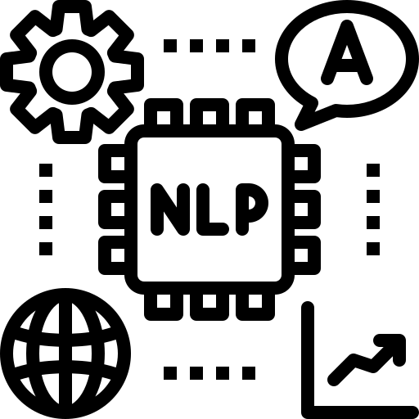
LARGE LANGUAGE MODEL

Slide 3
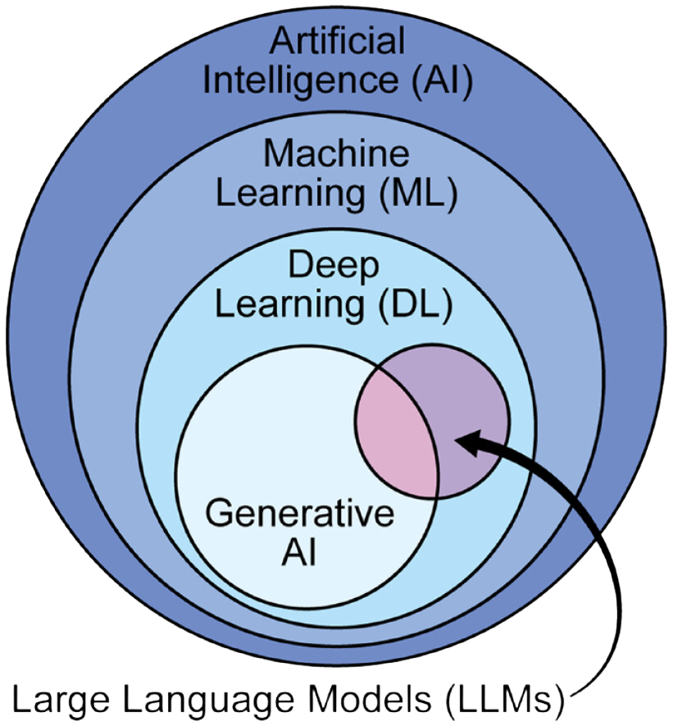
Large Language Model
LLMs are advanced AI models using neural network techniques with large parameter sets to process and understand human language.
These models are trained using self-supervised learning on massive datasets.
Large Language Model

Slide 4
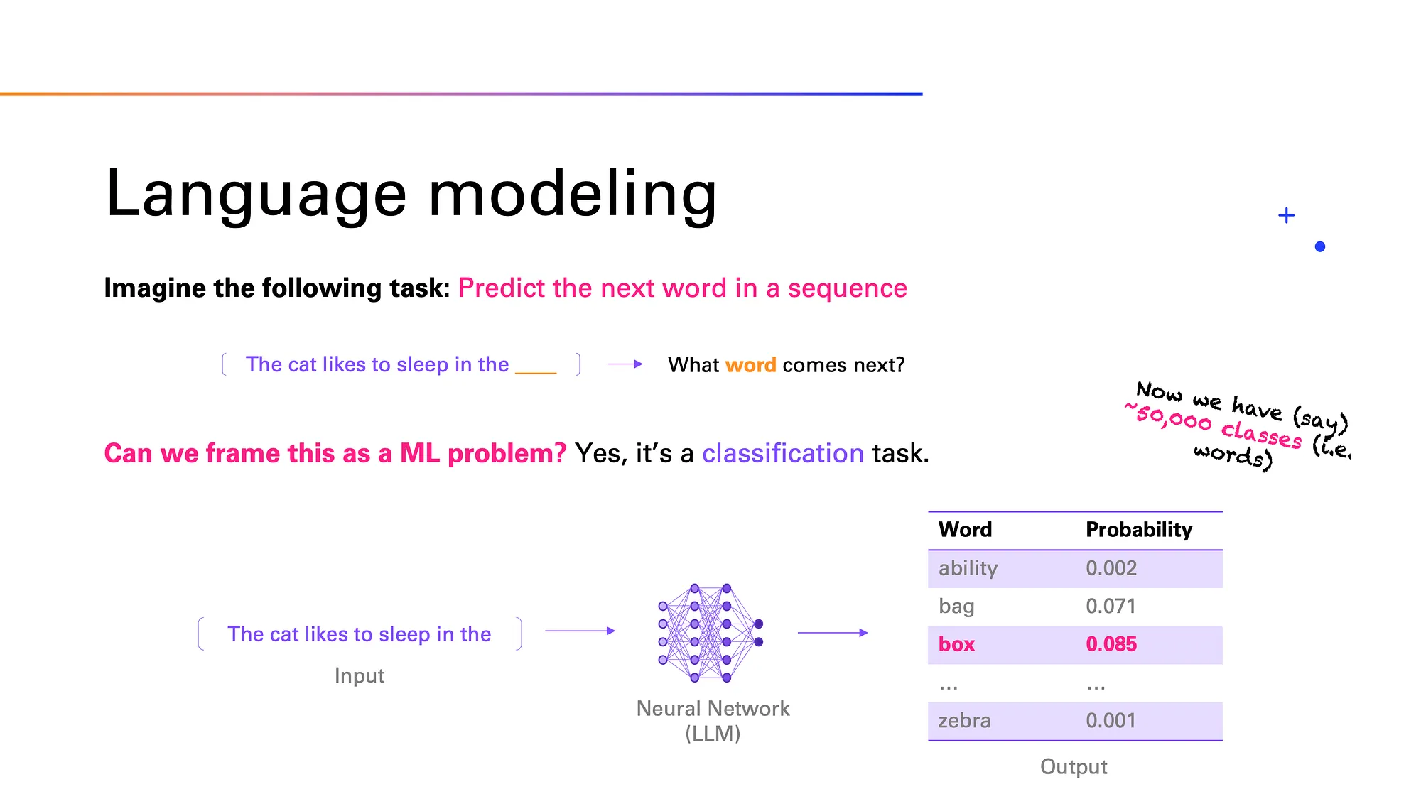
How do LLM works

Slide 5
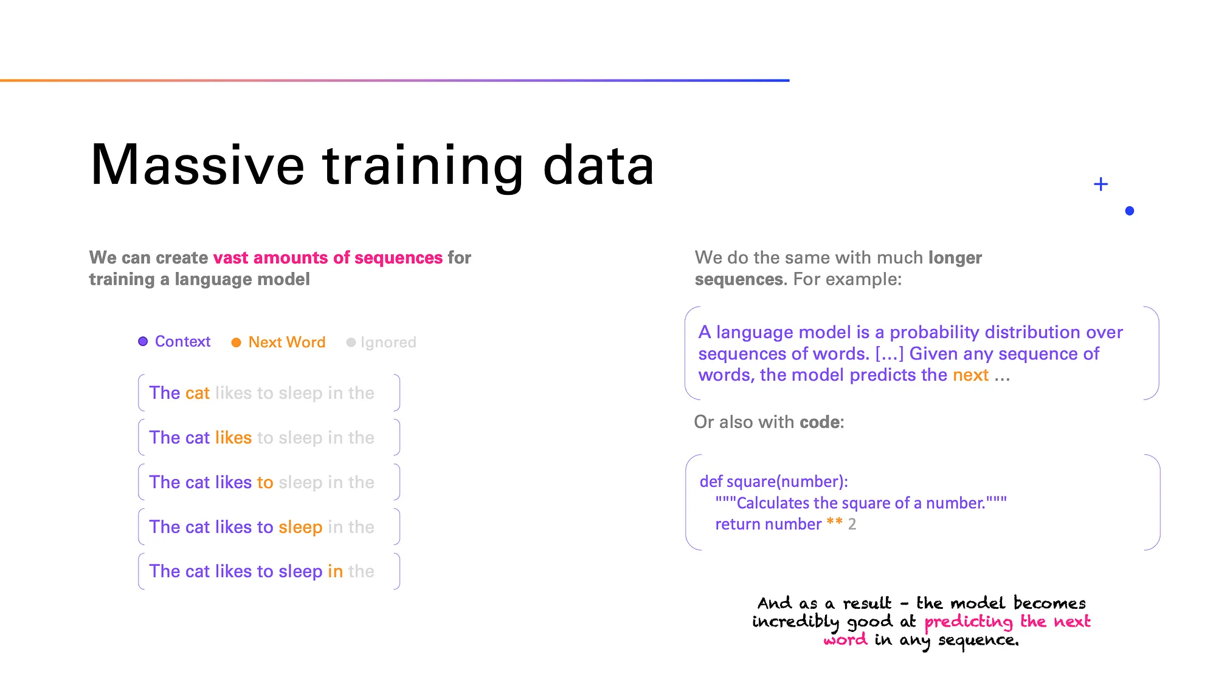
How do LLM works
To predict the next word we need large amounts of data

Slide 6
Popular LLM model
Bidirectional Encoder Representations from Transformer (BERT)
Generative Pre-Trained Transformer (GPT)
Purpose | Text Generation (NLG)
Directionality | Unidirectional (left-to-right)
Primary Use Cases | Text generation, Summarization, Code generation
Key Strength | Generating coherent, human-like text
Purpose | Text Understanding (NLU)
Directionality | Bidirectional (context from both sides)
Primary Use Cases | Text classification, Question answering, Named entity recognition
Key Strength | Understanding contextual relationships between words
Developed by OpenAI
Developed by Google

Slide 7
Transformer Architecture
Deep learning model that utilizes self-attention mechanism.
Build on encoder-decoder architecture, both encoder and decoder are composed of a series of layers that utilize self-attention mechanisms and feed-forward neural networks.
Enables the model to process input data in parallel, thus it is highly efficient for tasks involving sequential data

Slide 8
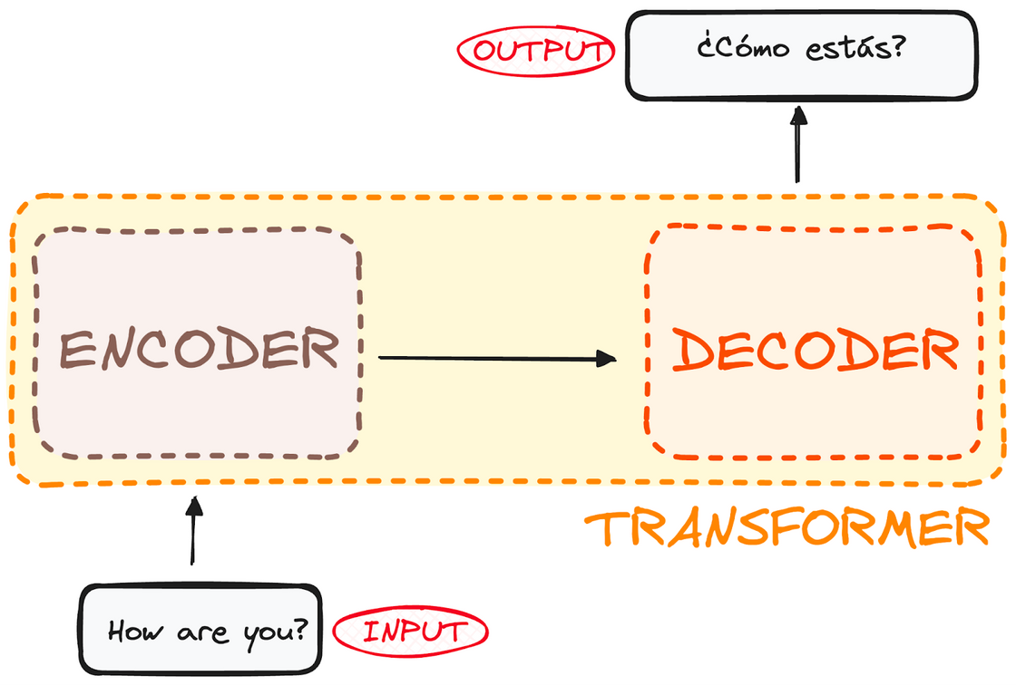
Transformer architecture
Encoder
Takes in input and outputs a matrix representation of that input.
Decoder
Takes in that encoded representation and iteratively generates an output.

Slide 9
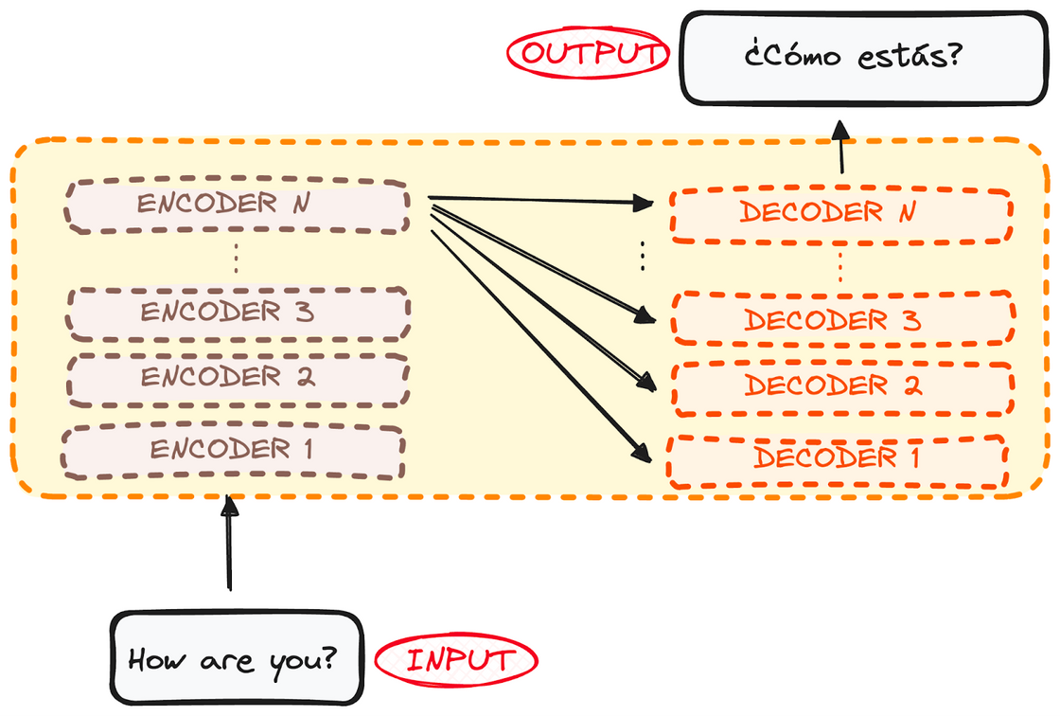
Transformer architecture
Encoder and decoder consist of a stack of multiple layers (same number of layers for each).
All encoders have the same structure, processing input sequentially from one layer to the next.
All decoders also share the same structure, receiving input from:
The last encoder layer.
The previous decoder layer.
The number of layers (N layers) can be adjusted based on the model's requirements.

Slide 10
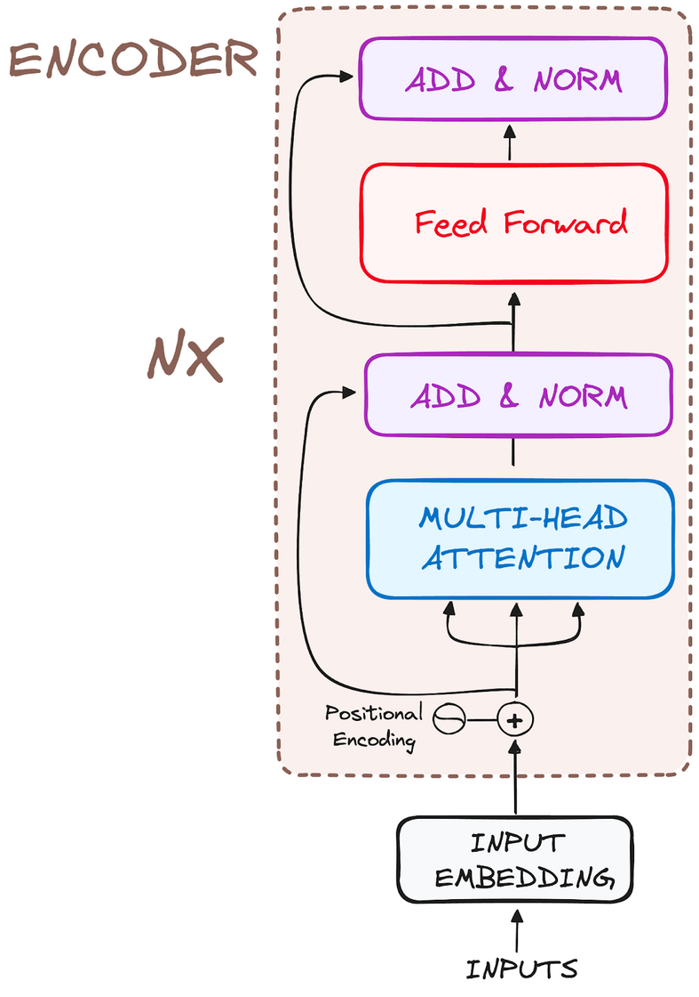
Transformer architecture
Encoder Workflow
The encoder is a key component of the Transformer architecture.
Primary Function: Transforms input tokens into contextualized representations.
Processes entire sequences, unlike earlier models that handled tokens independently.
Captures the context of each token relative to the whole input sequence.

Slide 11
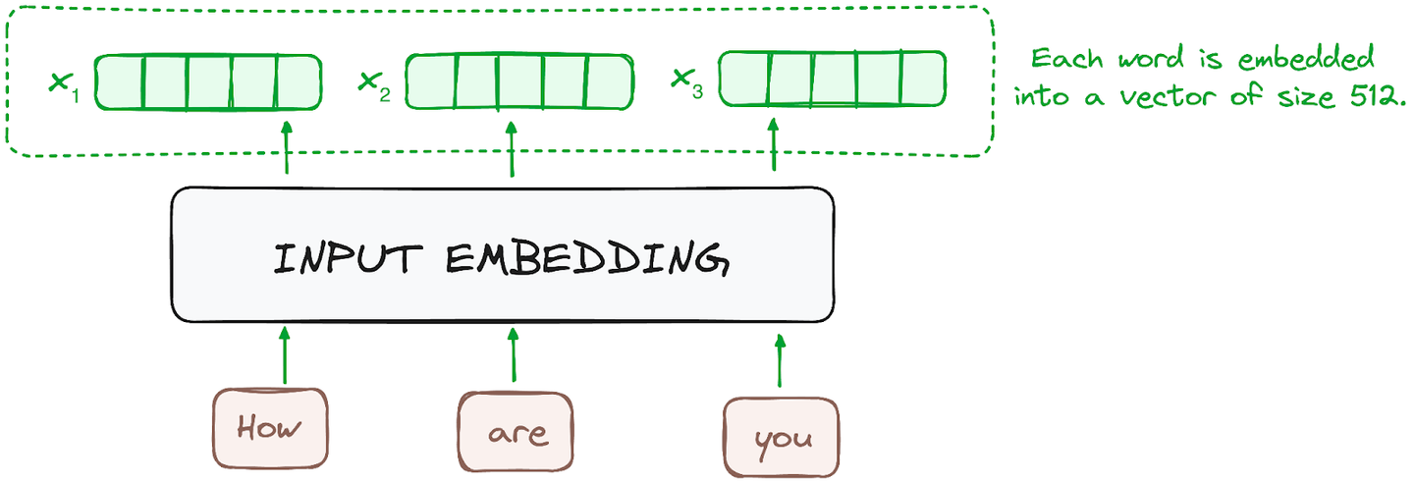
Transformer architecture
Step 1: Input Embeddings
Embedding happens only in the bottom-most encoder.
Input tokens (words or subwords) are converted into numerical vectors using embedding layers.
Purpose: Embeddings capture the semantic meaning of tokens.
All encoders process a list of fixed-sized vectors (size 512):
Bottom encoder: Processes word embeddings.
Other encoders: Process the output from the encoder directly below them.

Slide 12
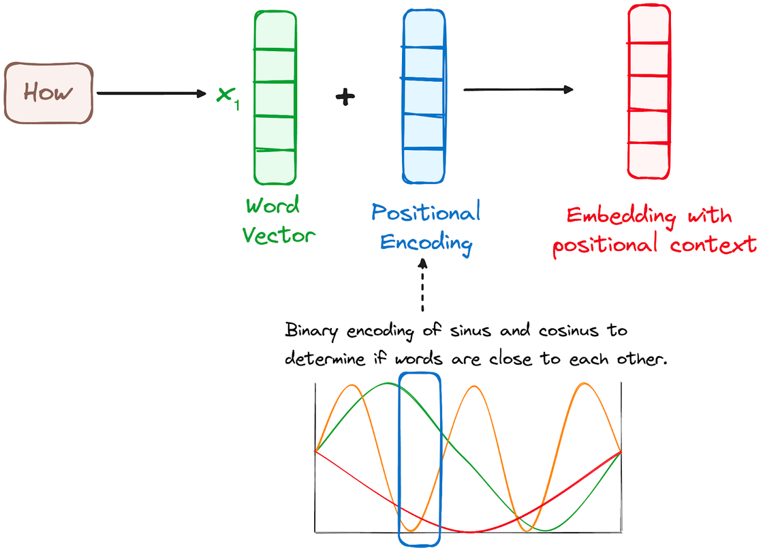
Transformer architecture
Step 2: Positional Encoding
Transformers lack a recurrence mechanism (like RNNs), so positional encodings are added to input embeddings.
Purpose: Provide information about the position of each token in the sequence.
Positional encodings are created using a combination of sine and cosine functions, making them suitable for sequences of any length.
Each dimension of the positional vector has unique frequencies and offsets of the wave.
Values range from -1 to 1, effectively representing each position in the sequence.

Slide 13
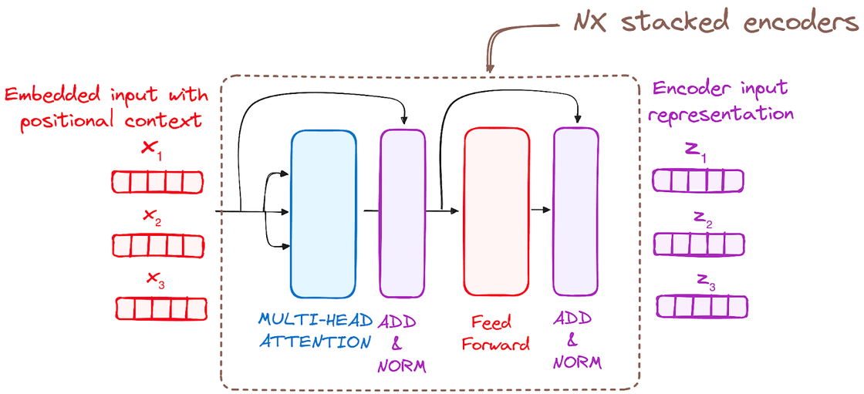
Transformer architecture
Step 3: Stack of Encoder Layers
Encoders process input through 6+ identical layers (in the original Transformer).
Each encoder transforms the input into contextual representations via two sub-modules:
Multi-Headed Self-Attention
Feed-Forward Neural Network

Slide 14
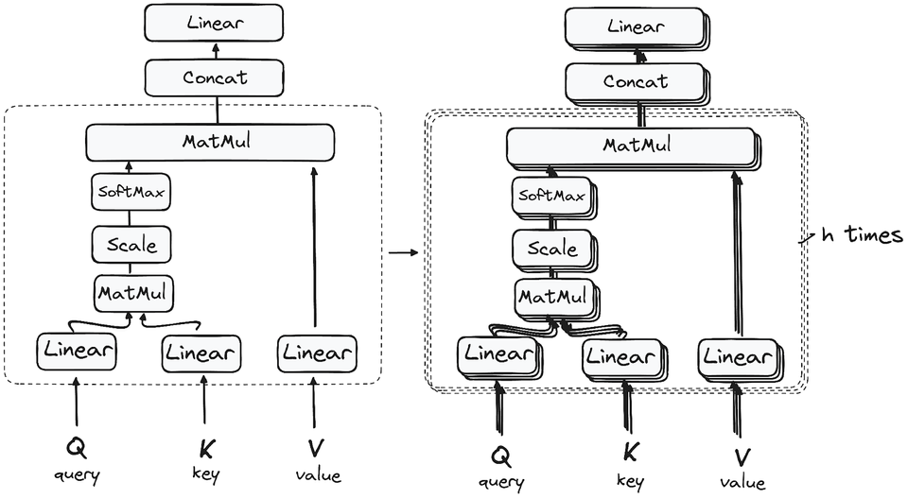
Transformer architecture
Step 3.1: Multi-Headed Self-Attention
Purpose: Relates each word in the input to other words.
Mechanism:
Query, Key, Value Vectors:
Query: Represents the current token.
Key: Matches with Query to calculate attention scores.
Value: Combined with weights to produce the output.
Matrix Multiplication: Compute dot product of Query and Key to get attention scores.
Scaling: Divide scores by √(dimension) for stable gradients.
Softmax: Converts scores into probabilities (attention weights).
Weighted Values: Multiply weights with Value vectors to focus on important tokens.
Multi-Head: Attention is split across multiple heads to capture diverse patterns.

Slide 15
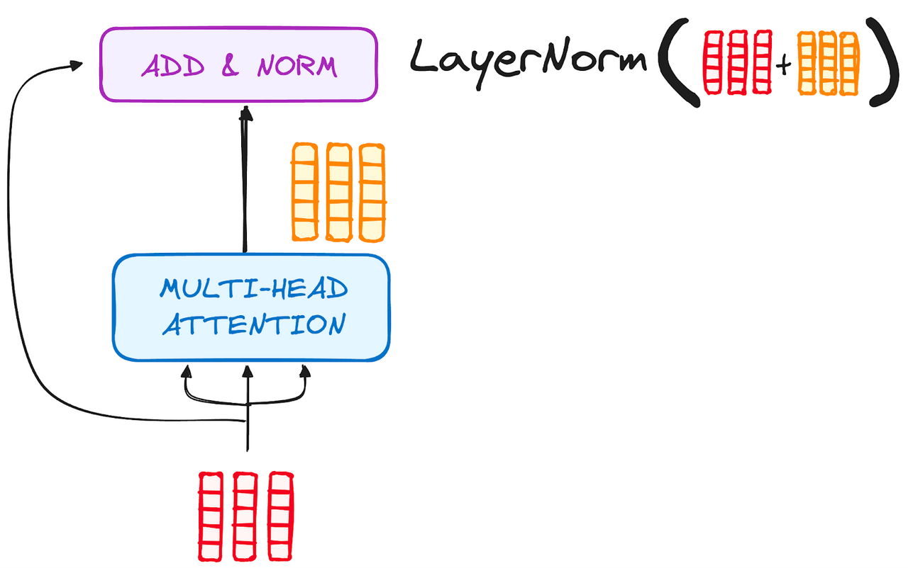
Transformer architecture
Step 3.2: Normalization and Residual Connections
Each sub-layer output is:
Normalized for stability.
Combined with its input using residual connections to prevent vanishing gradients.

Slide 16
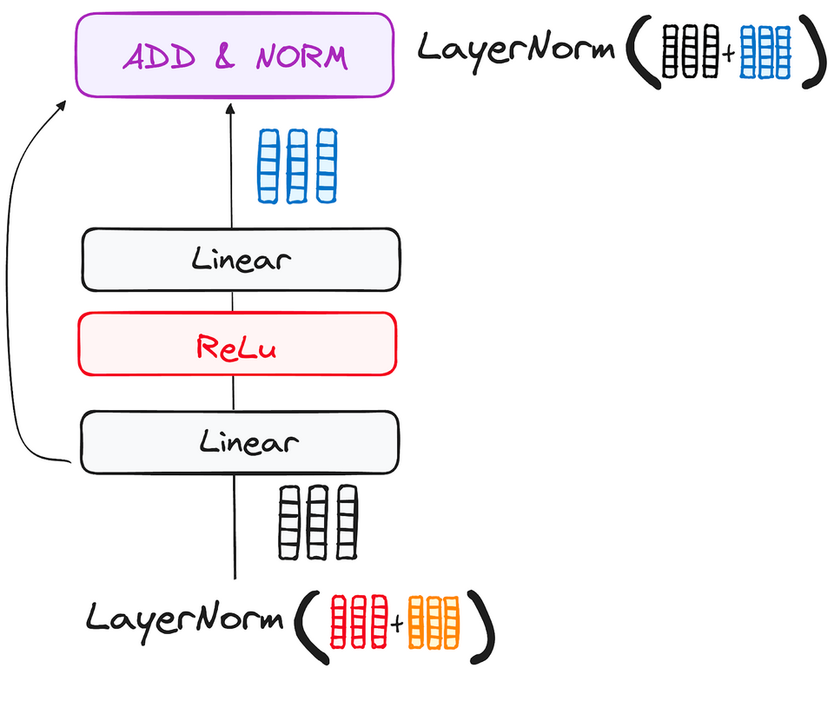
Transformer architecture
Step 3.3: Feed-Forward Neural Network
Structure:
Two linear layers with a ReLU activation in between.
Adds further abstraction to the input.
Output loops back through residual connections and is normalized.
Final encoder outputs context-rich vectors for the decoder to use during translation or generation.

Slide 17
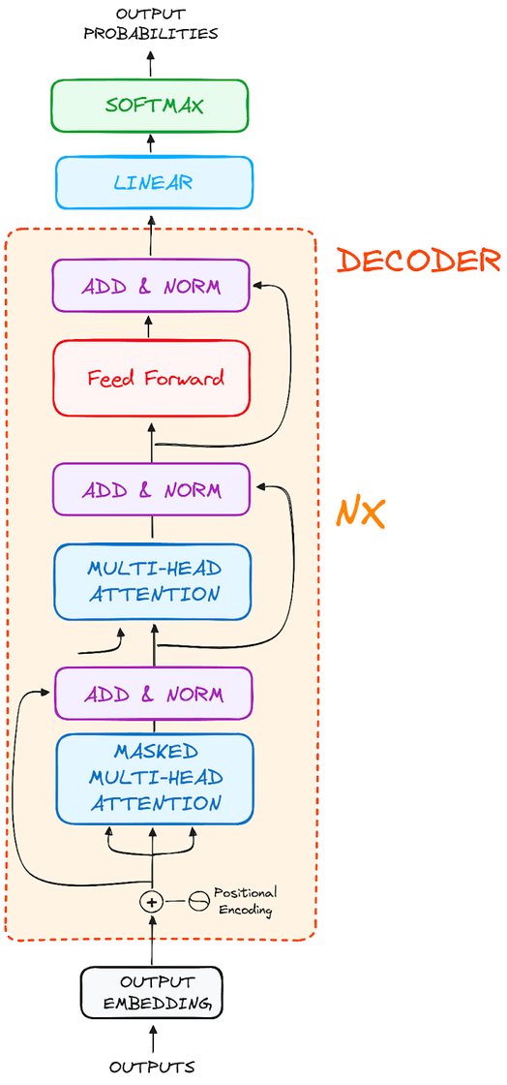
Transformer architecture
Decoder Workflow
The decoder is responsible for generating text sequences.
It mirrors the encoder's structure but includes two multi-head attention layers and a pointwise feed-forward layer.
Incorporates residual connections and layer normalization after each sub-layer.
Operates in an autoregressive manner, using previously generated tokens as input

Slide 18
Transformer architecture
Step 1: Output Embeddings
Converts input tokens (starting with a start token) into embeddings.
Embedding layer is identical to the encoder’s embedding mechanism.
Step 2: Positional Encoding
Adds positional information to embeddings using sine and cosine functions.
Outputs positional embeddings for sequential processing.

Slide 19
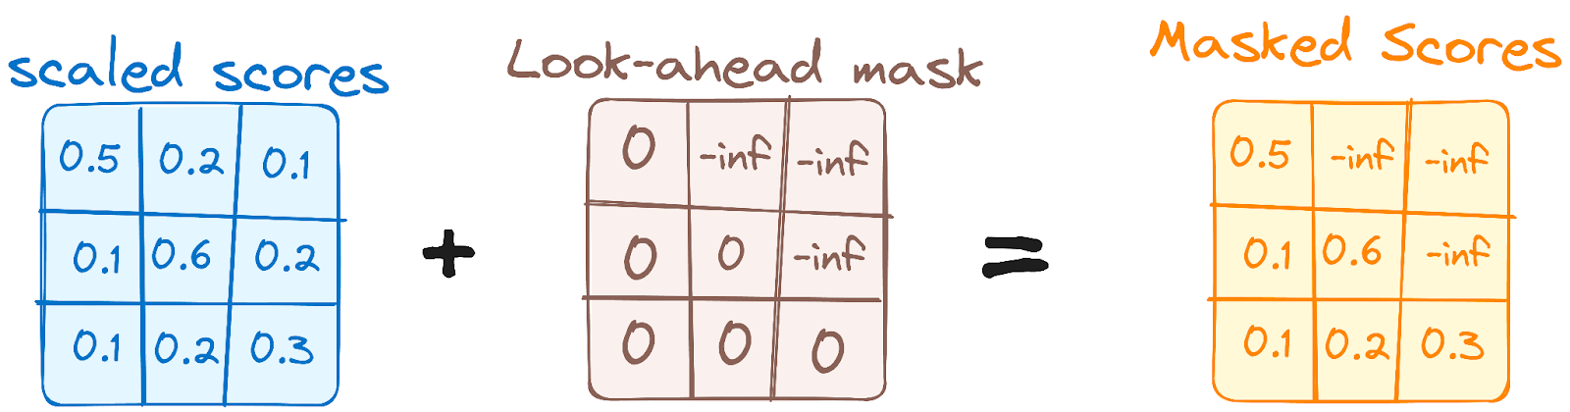
Transformer architecture
Step 3: Stack of Decoder Layers
Decoder consists of 6+ identical layers. Each layer has three main sub-components:
3.1 Masked Self-Attention:
Prevents each token from attending to future tokens (ensures autoregressive generation).
Example: While generating "are," it doesn't consider "you."

Slide 20
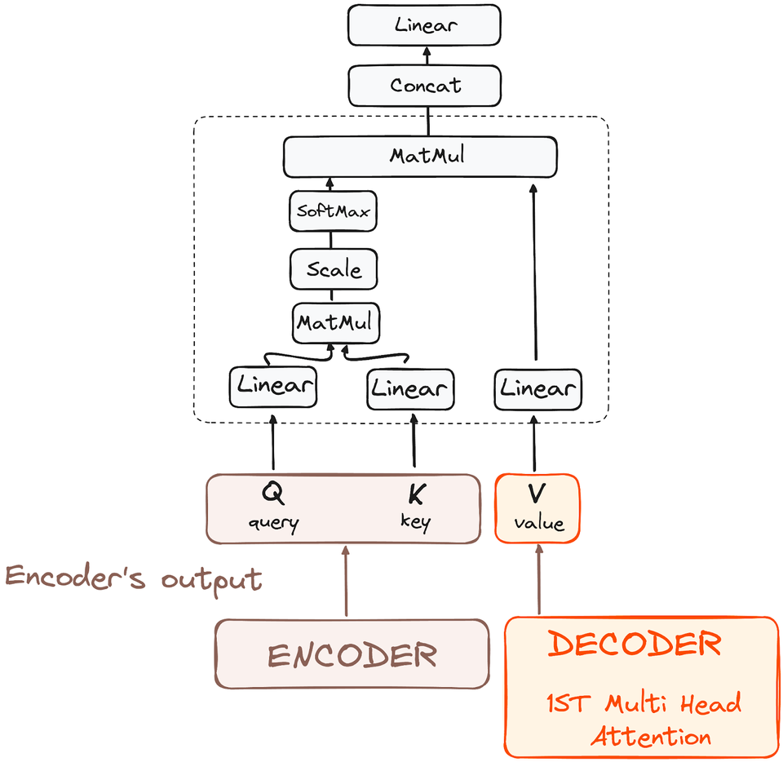
Transformer architecture
3.2 Encoder-Decoder Attention (Cross-Attention):
Queries come from the decoder, while keys and values come from the encoder's output.
Aligns the decoder with the encoder’s input for contextually relevant generation.

Slide 21
Transformer architecture
3.3 Feed-Forward Neural Network:
Similar to the encoder, applies a two-layer fully connected network with ReLU activation for further refinement.

Slide 22
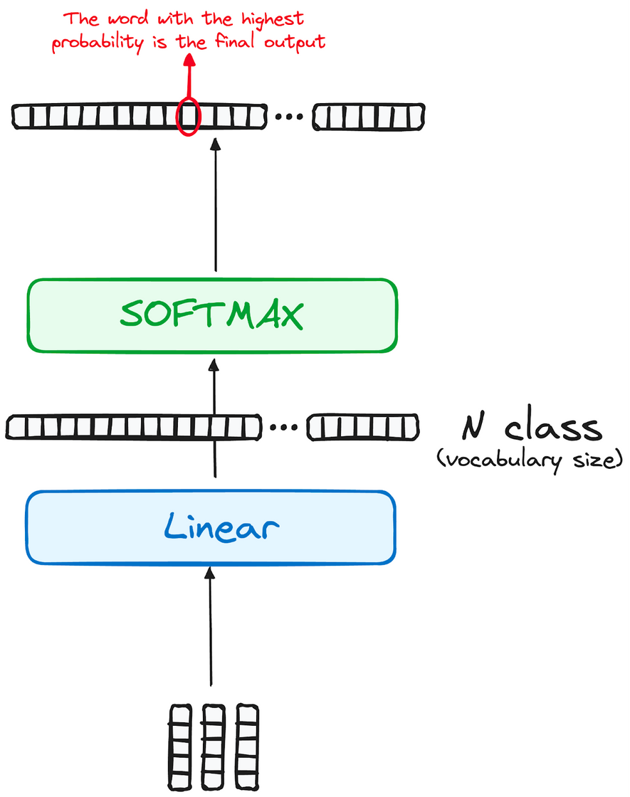
Transformer architecture
Step 4: Linear Classifier and Softmax
Linear Layer:
Converts the output into a vector with the size of the vocabulary (e.g., 1000 words → 1000-dimensional vector).
Softmax Function:
Transforms the vector into probabilities, where the highest probability corresponds to the predicted token.
Output Sequence:
The decoder generates tokens iteratively until it predicts an end token.

Slide 23
Transformer architecture
Residual Connections & Normalization:
Each sub-layer is followed by residual connections and layer normalization for stability and efficient gradient flow.
Final Output
The final predicted sequence is the model's output, enriched by the contextual attention from the encoder and the autoregressive decoding process.
The multi-layered approach allows the decoder to build nuanced representations, improving its predictive ability.

Slide 24
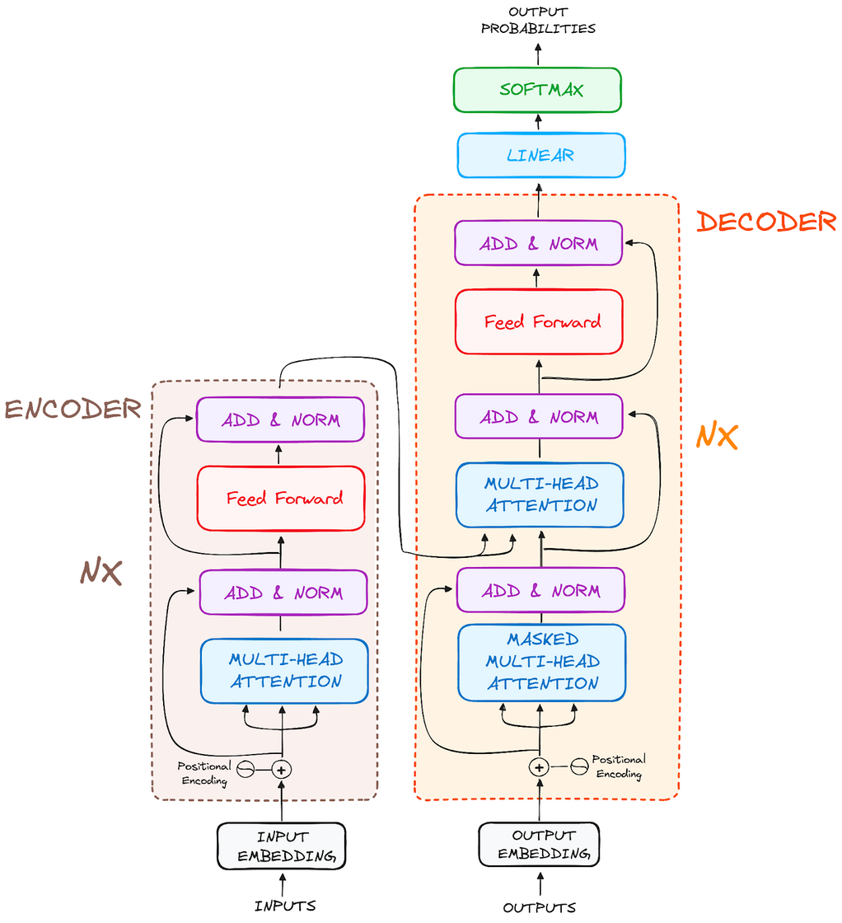
Transformer architecture

Slide 25


What is Large Language Model used for ?
Natural Language Processing

Slide 26
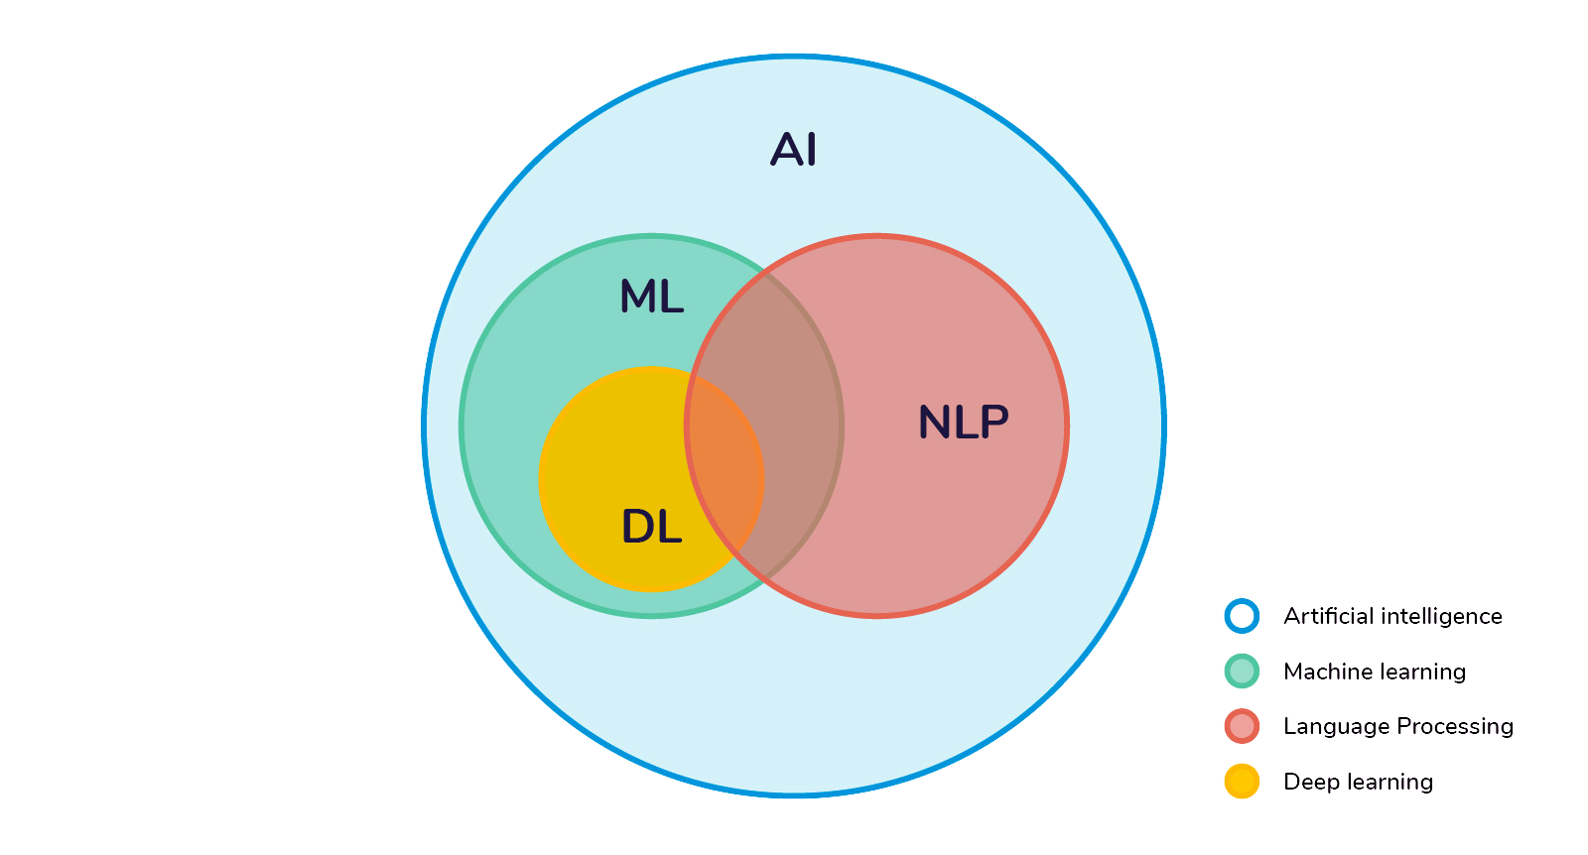
Natural Language Processing
Large Language Models (LLMs) leverage advanced neural network architectures, , to enable machines to process, understand, and generate human language effectively (such as RNNs, CNNs, and Transformers)

Slide 27
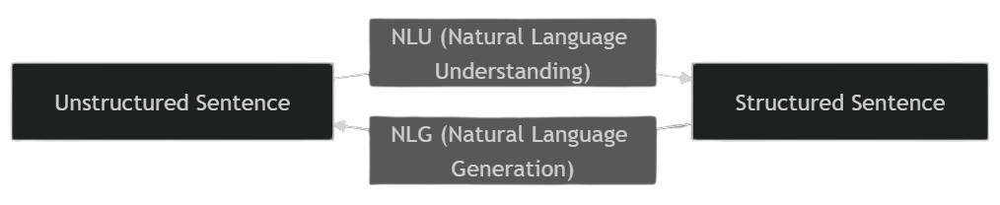
Components of NLP
Natural Language Understanding
Natural Language Generation

Slide 28
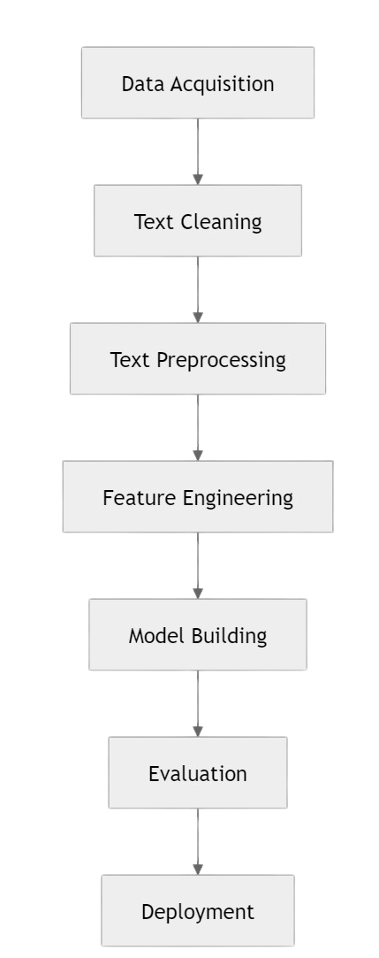
NLP Pipelines
A systematic approach to process and analyze natural language data (text or speech)
A series of steps that convert unstructured human language into structured data for further applications

Slide 29
1.Data Acquisition
Identify the NLP task and understand the type of data needed
Source:
Public datasets: Kaggle, Government databases
APIs: Access data from platforms like Reddit
PDF/Text Extraction: With library like PyPDF2 or Tesseract OCR
Data Augmentation Techniques (Optional)
Synonym Replacement
Back Translation
Adding Noise

Slide 30
2.Text Cleaning
Remove irrelevant data and make the text consistent
Techniques:
HTML Tag Removal: Remove formatting tags in web-scraped data.
Emoji Handling: Remove or convert emojis to text.
Spell Correction: Correct common typographical errors.
Garbage In Garbage Out!!

Slide 31
3. Text Preprocessing
Prepare text for feature extraction or modeling
Tokenization: Splitting text into words (word tokenization) or sentences (sentence tokenization).
Example: "I love NLP." → ["I", "love", "NLP", "."]
Stopword Removal: Remove common words like "the," "is," etc., which don’t add value.
Stemming and Lemmatization:
Stemming: Reduces words to their base form (e.g. "running" → "run").
Lemmatization: Converts words to their dictionary form (e.g. "better" → "good").

Slide 32
3. Text Preprocessing
Lowercasing: Normalize text by converting all to lowercase.
POS Tagging: Assign grammatical tags like nouns, verbs, etc.
Named Entity Recognition (NER): Identifies entities such as names, dates, locations.

Slide 33
4. Feature Engineering
Convert text into numerical data for modeling
Methods:
Bag of Words (BoW): Represents text as a collection of unique words with their frequencies.
Word Embeddings: Dense vector representations of words capturing their semantic meanings. Examples: Word2Vec, GloVe, FastText.
N-Grams: Represents sequences of adjacent words (e.g., "bigram": two words like "machine learning").
Dependency Parsing: Captures relationships between words in a sentence.

Slide 34
5. Model Building
Apply machine learning or deep learning model for NLP task
Approaches:
Heuristic Models:
Rule-based systems for specific patterns (e.g., regex for email detection).
Machine Learning Models:
Naive Bayes, Support Vector Machines (SVM), Random Forests for classification tasks.
Deep Learning Models (Current Trend):
RNNs, LSTMs, GRUs for sequence tasks like language modeling.
Transformers (e.g., BERT, GPT) for context-aware modeling.

Slide 35
6. Evaluation
Assess the performance of the model
Metrics:
Classification: Accuracy, Precision, Recall, F1-score.
Sequence Tasks: BLEU (for translation), ROUGE (for summarization).
Language Models: Perplexity (how well the model predicts the next word).

Slide 36
7. Deployment
Make the NLP model usable in production
Steps:
Export Model: Save the model and associated files (e.g., tokenizer, embeddings).
Setup Input Pipeline: Preprocess incoming data before prediction.
Inference Service: Deploy APIs or web servers to serve predictions.
Monitoring: Regularly track performance and retrain if needed.

Slide 37

thank you for listening!

